Slide 1


University Experience Programme
Brasenose College, Oxford

Slide 2
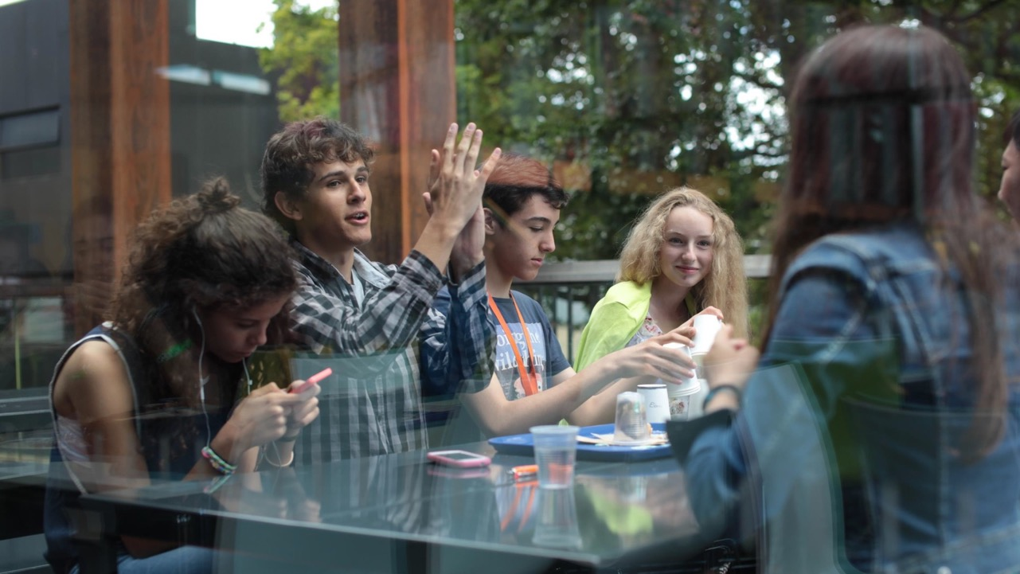

COURSE AIMS
University Experience Programme | Brasenose College, Oxford University
A specialist University Experience Programme (UEP) designed and set up with the specific aim of preparing students for access to the very best of British university education.
Our goal is to maximise your potential, to set you on the path to academic success.
The UEP course takes place one of the UK’s world-renowned universities: Brasenose College, allowing students unrivalled access to these privileged seats of learning.

Slide 3
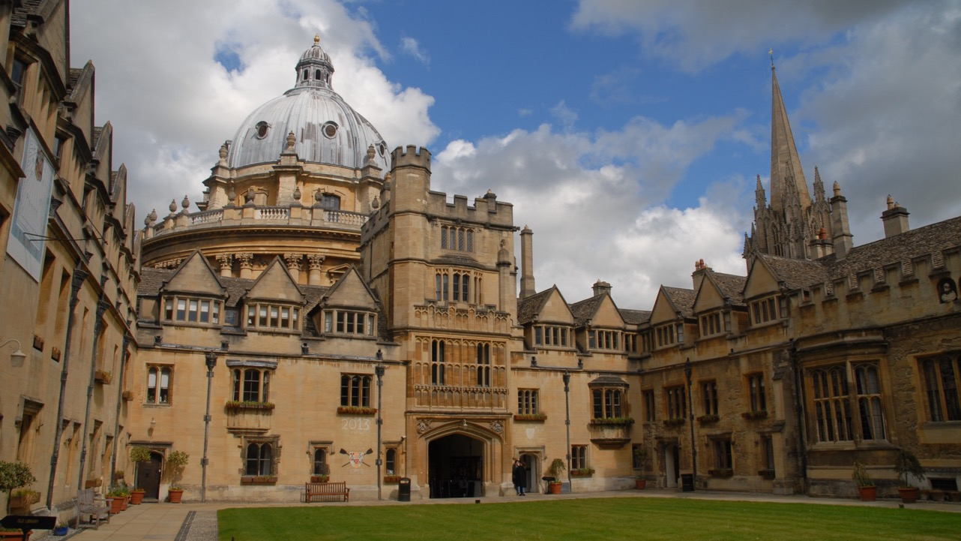
Brasenose College, Oxford University

Slide 4
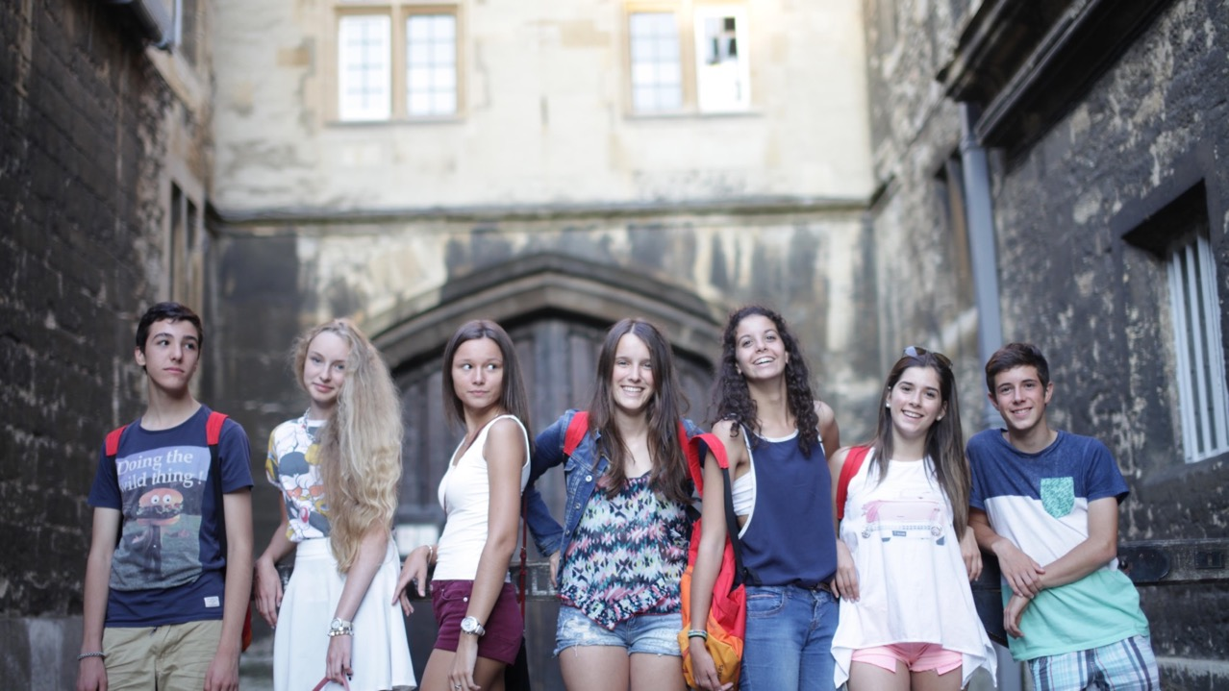
Brasenose College, Oxford University

Slide 5
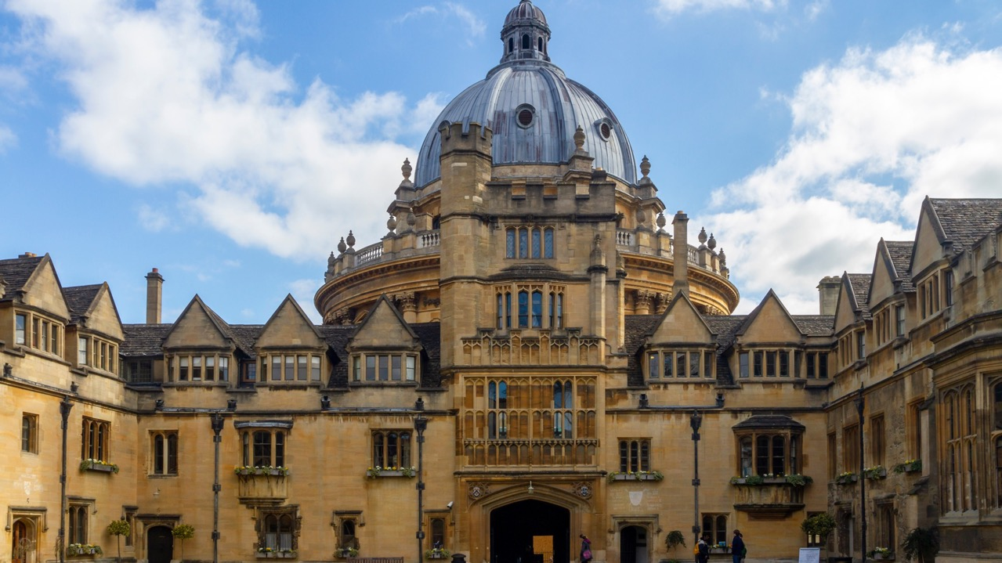
University Experience Programme | Brasenose College, Oxford University
City centre campus in the heart of one of the World’s Top 3 Universities
Safe and secure campus in the centre of the historic city of Oxford, minutes from shops, museums and historic attractions
Close-knit and welcoming college, committed to the pursuit of academic excellence.
Oxford is the former home of world-renowned writers, including JRR Tolkien, CS Lewis, Lewis Carroll and Philip Pullman, to name a few.

Slide 6

University Experience Programme | Brasenose College, Oxford University
COURSE FACTS
Start dates: 11 August
Course length: 7 or 14 nights
Age range: 15-17
Hours of learning: 20 or 40 hours
Entry requirements: Pre-course assessment
Minimum level: B1+
Class size: 12

Slide 7
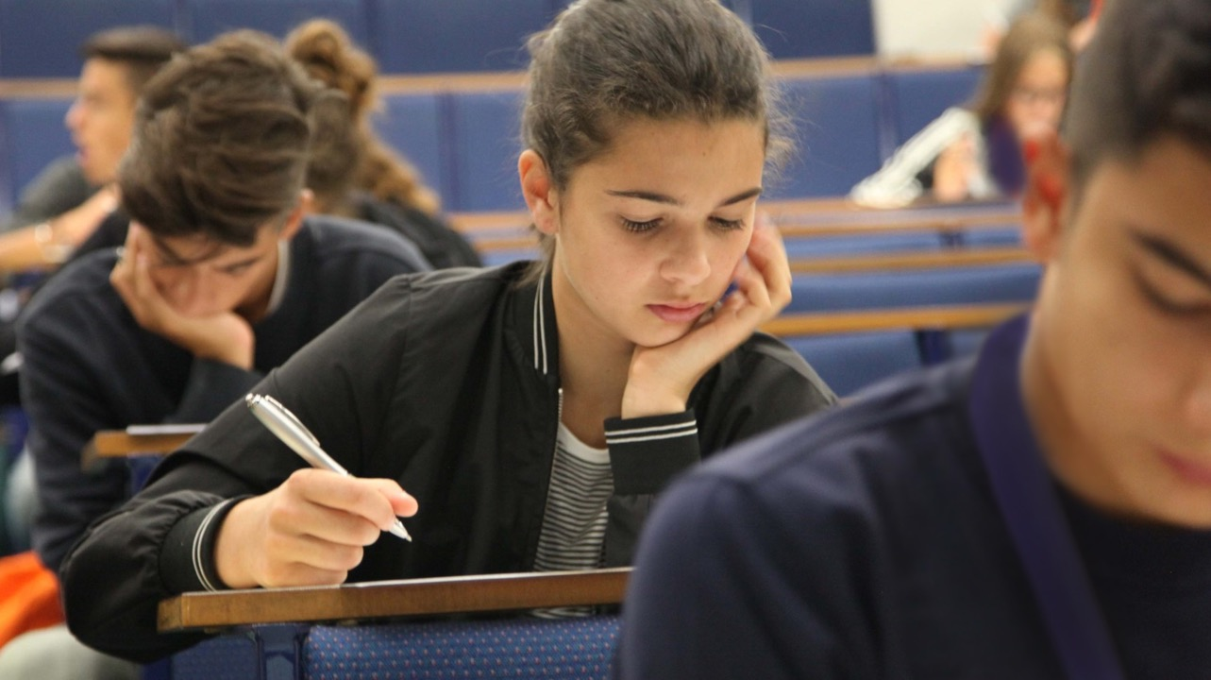
University Experience Programme | Brasenose College, Oxford University
Who is it for ?
For inspired and high-reaching individuals looking to take their academic knowhow to the next level for higher education or exams.
This course helps develop understanding through a series of academic workshops, designed to increase confidence and communication skills for academic success.

Slide 8
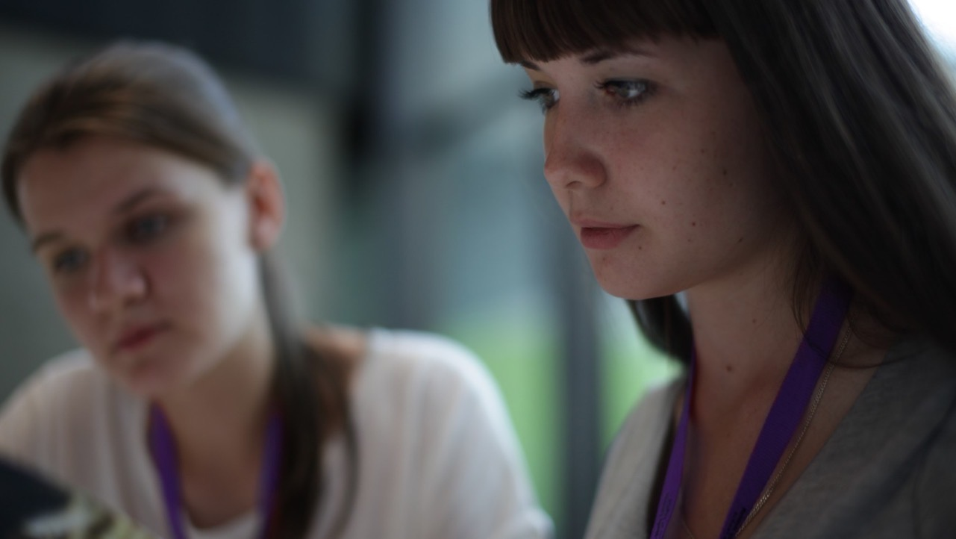
University Experience Programme | Brasenose College, Oxford University
THE COURSE
Immerse yourself in academic life, visiting Oxford colleges and attending lectures from guest speakers with first-hand experience of university life in the UK.
Seminar Skills
Essay Writing
Effective Presentations
Proof-reading
Group Work
Multicultural Communication
Research Skills
Active Listening
In addition, you will take part in a variety of workshops designed to help you achieve academic success.

Slide 9

University Experience Programme | Brasenose College, Oxford University
Week 1 | Day 1 | Day 2 | Day 3 | Day 4 | Day 5 | Day 6 | Day 7
Morning |  | Breakfast
 | Arrivals, welcome and by the Principal | Active Listening Seminar | Seminar Skills Seminar | Research Skills Seminar | Essay Writing Seminar | Multi-cultural Communication Seminar | A full day in London visiting G5 University Imperial College A River Thames Cruise and Sightseeing Tour
Afternoon | Course induction, overview and familiarisation | Lunch
 |  | Active Listening Practical | Seminar Skills Practical | Research Skills Practical | Essay Writing Practical | Multi-cultural Communication Practical
 |  | A historic walking tour of Oxford | Christ Church College, Oxford University Visit | Free Time in Oxford City Centre | Punting in Oxford on the River Thames | Free Time in Oxford City Centre
Evening |  | Dinner
 | Welcome evening | Quiz Night | Oxford by night | Movie night at the Cinema | Guest Speaker: Life as an Oxford Student | Karaoke Evening | Oxford Disco evening
 |  | Relax and Unwind

Slide 10
University Experience Programme | Brasenose College, Oxford University
Week 2 | Day 8 | Day 9 | Day 10 | Day 11 | Day 12 | Day 13 | Day 14
Morning |  | Breakfast
 | Arrivals, welcome and by the Principal | Effective Presentations Seminar | Proof Reading Seminar | Group Work Seminar | University Admissions Seminar | Personal Statement Seminar | A full day in Stratford-upon-Avon A visit to the birthplace of William Shakespeare
Afternoon | Course induction, overview and familiarisation | Lunch
 |  | Effective Presentations Practical | Proof Reading Practical | Group Work Practical | University Admissions Practical | Personal Statement Practical
 |  | Visit the Ashmolean Museum | Visit Blenheim Palace | Free Time in Oxford City Centre | Afternoon Tea | Free Time in Oxford City Centre
Evening |  | Dinner
 | Welcome evening | An evening at the Theatre | Souvenir shopping | Bowling night in Oxford | Guest Speaker: Applying to a UK University | Formal dinner and Graduation Ceremony | Oxford Disco evening
 |  | Relax and Unwind

Slide 11


